Slide 1
TEXT FILE SEARCH ENGINE
By-
Raghav Somani 130123029
Prakhar Shukla 130123047
Vaibhav Adlakha 130123041
Madhur Bhattar 130123011
Akshit Jain 130123005
Sithal Nimmagadda 130123023
Shivanshu Chouhan 130103084
Ravi Teja Reddy 130123017
Saurabh Agrawal 130123035

Slide 2
Objective
The objective of this program is to make a text file search engine which sorts the names of the text files in descending order according to their occurrences.
The main idea of this project is to hunt for the best algorithm and data structure to serve the purpose.
An analysis of 6 different data structure and techniques have been done to make out a satisfactory relation between asymptotic theoretical analysis and experimental data of space and time complexities.
The program takes the help of efficient inbuilt basic data structures and algorithms provided by C++ in their Standard Template Library which is inbuilt in the recent versions of C++11.

Slide 3
Running the program
The program uses the unordered map feature of C++11 which can be compiled by C++11
g++ -std=c++11 main.cpp

Slide 4
Implementation via Different Techniques
The code has been implemented using the following techniques –
Hash table using linked list
Hash table using vector storing frequency
Linear search algorithm using linked list
Balanced Trees using maps storing frequency
Hash Table using Balanced Trees storing frequency
Unordered maps storing frequency

Slide 5
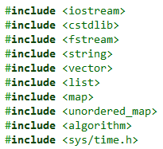

Preprocessors Directives
The preprocessor examines the code before actual compilation of code begins and resolves all these directives before any code is actually generated by regular statements.
Preprocessor Directives used –
Libraries
iostream - input/output stream handling
fstream - input/output file stream handling
algorithms - functions like find(), count(), sort()
string - string datatype and string manipulation
vector - vector datatype and functions
list - linked list datatype and functions
map - map data structure (balanced tree used internally)
unordered_map (C++11) – Uses efficient hash tables internally
if statement – to find out which OS program is running.

Slide 6
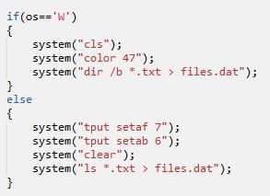
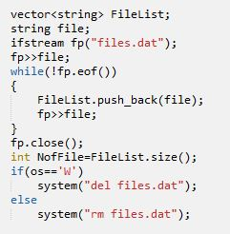
Extracting names of Text Files
Text files need to be known in names and number to proceed further into the code. This has been done in 2 steps –
if statement checks OS then system command is used to list all the .txt files of the current directory in files.dat
FileList is vector of strings which stores the contents of files.dat. files.dat is deleted afterwards.
NofFile stores number of text files

Slide 7
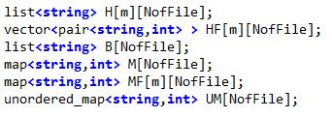
Initializing Data structures Required
5 different data structures for different cases are initialized.
Case 1 : Hash table of linked lists for each file with m slots
Case 2 : Hash table of vectors for each file. Each vector cell contains a pair to store both string and its corresponding frequency.
Case 3 : Linked list for each file.
Case 4 : Map (balanced tree) for each file where each node of a map contains the string and its corresponding frequency.
Case 5 : Hash table of maps (balanced trees) where each map contains the string and its corresponding frequency.
Case 6 : Unordered Maps where each bucket has nodes containing string and its frequency.

Slide 8

Hash Function used
We use the Rolling Hash function in which the input string is alphanumeric and is treated as a 27 base number reduced to modulo m (number of slots in the Hash Table).
a is taken as 0, b as 1, …, z as 25 and any other non alphabet character is taken as 26.
The hash function is
$h\left(s\right)=\left( \sum_{i=0}^{len−1}{ a_{i} . {27}^{i} }\right)mod m$
$s= <a_{len−1}a_{len−2}…..a_{0}>$

Slide 9
Case - 1
Hash table using linked list

Slide 10
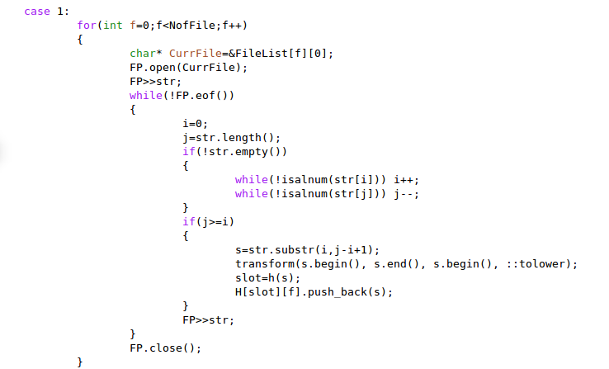
Case 1 - Inserting
We traverse the string from the start and the end till we encounter alphanumeric characters in order to get rid of punctuations if any. We take the valid substring and transform it in to lower case. Now we calculate the slot number by using hash function and push the string Then we read the next string

Slide 11
Case 1 – Insertion (Visual Representation)
0
the
and
is
will
1
be
for
could
be
Hash Function
2
go
to
market
buy
3
there
space
sky
space
there
4
in
wonder
because
went
3
5
apple
boy
girl
gone
Inserting the word – “there”

Slide 12
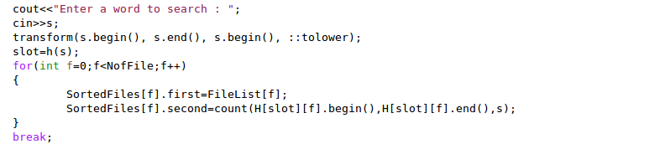
Case 1 – Searching
Word entered to search is transformed to lower case. Slot number is calculated using hash function. File name and the frequency of the word in the pair is stored in SortedFiles, which is an array of pairs.

Slide 13
Case 1 – Searching (Visual Representation)
0
the
and
is
will
1
be
for
could
be
Hash Function
2
go
to
market
buy
Count = 1
Count = 0
3
there
space
sky
space
Count = 2
4
in
wonder
because
went
3
5
apple
boy
girl
gone
Searching for the word – “space”

Slide 14

Case 1 – Theoretical Analysis
The hash function calculates the hash value (slot index) of the hash table in constant time for a particular string and is inserted in the linked list. We know that insertion in a linked list takes $O(1)$ time. Let the total number of words in all the text files be $n$. So the total order of insertion of all the words will be $θ(n)$.
In case of searching let us assume we have a uniform hash function. So that the number of nodes in a linked list corresponding to each file and each slot will be $\frac{n}{F.m}$.
Taking $\frac{n}{F.m}= α$, the time taken to count the occurrences of a word in a linked list is $O(α)$. Therefore total search time complexity is $O(F.α)$.

Slide 15

Case 1 – Pros and Cons
Pros –
It has a very efficient insertion time of $θ(n)$.
Cons –
As each word is stored every time it appears on the file, so huge amount of memory is wasted.
A Linked list takes up a lot of space in pointers, making the data structure bulky.
Hash function is calculated for every string, which takes a bit of extra time.
Time taken to search a word is linear in the number of nodes in the linked list.

Slide 16
Case - 2
Hash table using vector storing frequency

Slide 17
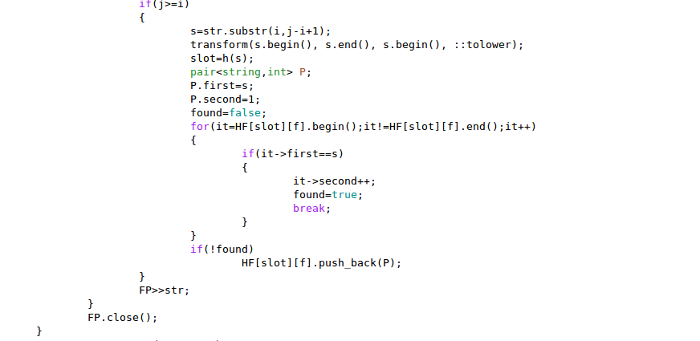
Case 2 – Insertion
We traverse the string from the start and the end till we encounter alphanumeric characters in order to get rid of punctuations if any. We take the valid substring and transform it in to lower case. Now we calculate the slot number by using hash function.
if the substring is already hashed then its frequency is incremented.
if not found, substring is hashed and its frequency is made 1.
Process is repeated till the end of the file.

Slide 18
Case 2 – Insertion (Visual Representation)
0
in | 45
to | 11
be | 3
1
cause | 34
will | 25
go | 12
Hash Function
2
our | 4
son | 1
sank | 2
3
the | 8
burn | 11
sun | 3
the | 7
4
down | 16
doe | 6
went | 9
3
5
bye | 4
star | 1
moon | 2
Inserting the word – “the”

Slide 19
Case 2 – Insertion (Visual Representation)
0
in | 45
to | 11
be | 3
1
cause | 34
will | 25
go | 12
Hash Function
2
our | 4
son | 1
sank | 2
3
sun | 3
the | 7
burn | 11
black | 1
4
down | 16
doe | 6
went | 9
3
5
bye | 4
star | 1
moon | 2
Inserting the word – “black”

Slide 20
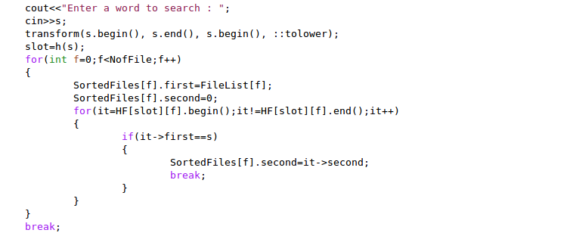
Case 2 – Searching
Word entered to search is transformed to lower case. Slot number is calculated using hash function. The word is searched in the string variable of every element of the vector corresponding to the file and its calculated slot.
If the word is found then the integer variable of that vector element, representing its frequency is returned.
Else if the word is not found, zero is returned.

Slide 21
Case 2 – Searching (Visual Representation)
0
in | 45
to | 11
be | 3
1
cause | 34
will | 25
go | 12
Hash Function
2
our | 4
son | 1
sank | 2
3
sun | 3
the | 7
burn | 11
4
down | 16
doe | 6
went | 9
3
5
bye | 4
star | 1
moon | 2
Frequency = 7
Searching the word – “the”

Slide 22
Case 2 – Searching (Visual Representation)
0
in | 45
to | 11
be | 3
1
cause | 34
will | 25
go | 12
Hash Function
2
our | 4
son | 1
sank | 2
3
sun | 3
the | 7
burn | 11
4
down | 16
doe | 6
went | 9
3
5
bye | 4
star | 1
moon | 2
Frequency = 0
Searching the word – “girl”

Slide 23

Case 2 – Theoretical Analysis
The hash function calculates the hash value (slot index) of the hash table in constant time. The string is first searched in the vector. Since a word will appear at most once in a Hash table so the strings stored this time will be DISTINCT. Assuming uniform hashing and uniform occurrence of every word in all the file, the average number of elements in the vector is $\frac{n}{F.m.f}$. ( $f$ is the average frequency of any word).
Taking $\frac{n}{F.m}= α$, the time complexity of single insertion is $O(\frac{α}{f})$. So to insert $n$ words, the average time complexity is $O(\frac{n.α}{f})$.
In case of searching we iterate through the calculated slot number in each file. As soon as we encounter the string, we return the frequency part. So the average search time complexity for one file will be $O(\frac{α}{f})$. Therefore total search time complexity is $O(F.\frac{α}{f})$.

Slide 24

Case 2 – Pros and Cons
PROS
Searching takes $O(\frac{α}{f})$ which is better than $θ(α)$ in case 1 assuming f>1.
Space complexity of this case is $θ(\frac{n}{f})$ better than $θ(n)$ of first case.
As no pointers used so an appreciable constant amount of space saved.
CONS
Insertion takes $O(\frac{n.α}{f})$ which is worse than $θ(n)$ of case 1 generally.

Slide 25
Case - 3
Linear search algorithm using linked list

Slide 26
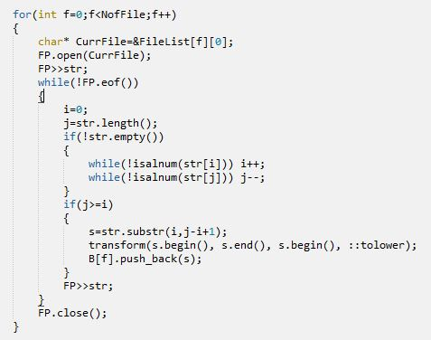
Case 3 – Insertion
We traverse the string from the start and the end till we encounter alphanumeric characters in order to get rid of punctuations if any. We take the valid substring and transform it in to lower case.
This substring is then added to Linked List.

Slide 27
Case 3 – Insertion (Visual Representation)
i
want
to
go
to
the
market
Inserting the word – “market”

Slide 28
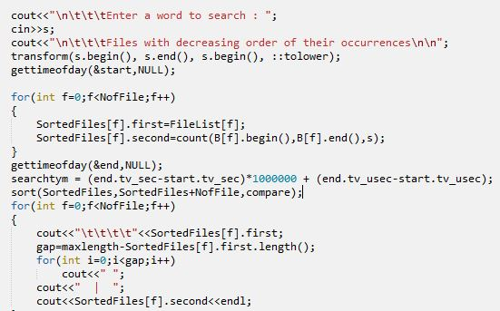
Case 3 – Searching
Word entered to search is transformed to lower case.
Word is then searched in a file by searching in Linked List of that file.
Whenever the string matches, Frequency is incremented by 1.
If no match is found, Frequency returned for that file is 0.
Same process is repeated for all files

Slide 29
Case 3 – Searching (Visual Representation)
i
want
to
use
soap
to
wash
Frequency = 0
Frequency = 1
Frequency = 2
Searching the word – “to”

Slide 30

Case 3 – Theoretical Analysis
Insertion in the link list takes $O(1)$ time. Inserting $n$ words will take $θ(n)$ time.
A brute force searching leads to an average time complexity of $O\left(\frac{n}{F}\right)$ in each file. For F files, the time complexity becomes $θ\left(\frac{n}{F}.F\right)= θ(n)$.

Slide 31
Case 3 – Pros and Cons
Pros –
It takes even less time (via constant factor) than that in Case 1 as no hash values are calculated.
Cons –
As each word is stored every time it appears on the file, so huge amount of memory is wasted.
A Linked list takes up a lot of space in pointers, making the data structure bulky.
Time taken to search a word is linear in the number of nodes in the linked list.

Slide 32
Case - 4
Balanced Trees using maps storing frequency

Slide 33
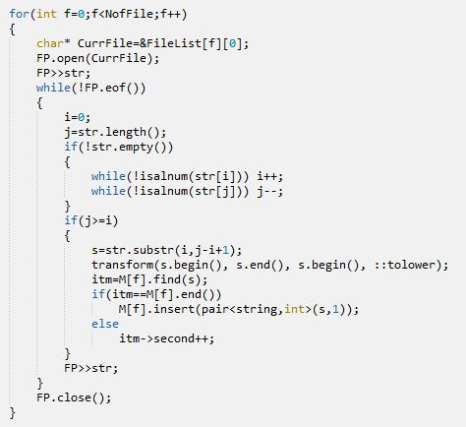
Case 4 – Insertion
We traverse the string from the start and the end till we encounter alphanumeric characters in order to get rid of punctuations if any. We take the valid substring and transform it in to lower case.
Substring is searched in the map for that particular file.
If the substring is found then frequency is incremented by 1.
Else the substring is added as a new node to the balanced tree(map) with frequency 1.

Slide 34
Case 4 – Insertion (Visual Representation)
it
35
has
23
told
9
god
11
hit
4
just
15
was
23
ate
16
great
10
help
3
hut
1
the
7
jam
2
the
8
wall
5
zebra
1
Inserting the word – “the”

Slide 35
Case 4 – Insertion (Visual Representation)
it
35
has
23
told
9
god
11
hit
4
just
15
was
23
ate
16
great
10
help
3
hut
1
the
7
jam
2
the
8
wall
5
zebra
1
Inserting the word – “hut”

Slide 36
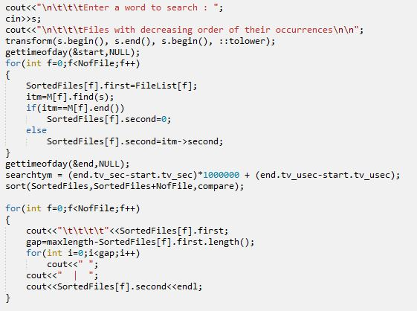
Case 4 – Searching
Word entered to search is transformed to lower case. The word is searched in the map of a particular file-
If the word is found then its frequency is returned.
Else if the word is not found, zero is returned.
Process is repeated in maps of all files.

Slide 37
Case 4 – Searching (Visual Representation)
it
35
has
23
told
9
god
11
hit
4
just
15
was
23
ate
16
great
10
help
3
hut
1
jam
2
the
7
wall
5
zebra
1
Searching the word – “the”

Slide 38
Case 4 – Searching (Visual Representation)
Frequency = 0
it
35
has
23
told
9
god
11
hit
4
just
15
was
23
ate
16
great
10
help
3
hut
1
jam
2
the
7
wall
5
zebra
1
Searching the word – “moon”

Slide 39
Case 4 – Suggestions for fail search
If the word is not present in any of the files, we search for the strings which comes just AFTER and just BEFORE the searched string in lexicographic order. This is done using the lexicographic ordering which the Map uses in it.
This string is given as a suggested word if and only if its length differs by at most 1.

Slide 40

Case 4 – Theoretical Analysis
Assuming uniform hashing and uniform occurrence of words in all the text files, the average number of nodes in any Map will be $\frac{n}{F.f}$. The average height of a Map will be $log⁡(\frac{n}{F.f})$. So the total time taken to insert $\frac{n}{F}$ elements in a map of a file is of the order $O(\frac{n}{F}\log\left(\frac{n}{F.f}\right))$. So the time complexity to build all $F$ Maps is $O\left(F.\frac{n}{F}\log\left(\frac{n}{F.f}\right)\right)=O(n\log\left(\frac{n}{F.f}\right))$.
The search time complexity is proportional to the height of any Map i.e., $log⁡(\frac{n}{F.f})$. So total search time complexity is $F.log⁡(\frac{n}{F.f})$.

Slide 41
Case 4 – Pros and Cons
Pros –
Search time is logarithmic in the number of nodes as Maps use balanced trees internally.
No hash value is calculated so a constant time gain is achieved.
Very less space is used as just one node is sufficient to represent all the same words in a file.
Cons –
Insertion time is not linear in the number of nodes in the Map.
Pointers take up a appreciable constant factor of space.

Slide 42
Case - 5
Hash Table using Balanced Trees storing frequency

Slide 43
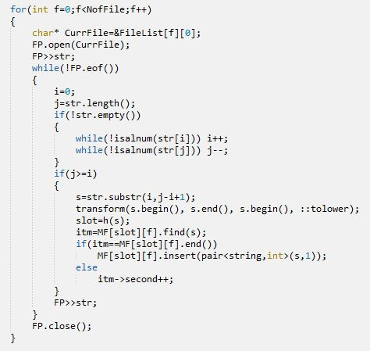
Case 5 – Insertion
We traverse the string from the start and the end till we encounter alphanumeric characters in order to get rid of punctuations if any. We take the valid substring and transform it in to lower case.
Slot number of the substring is calculated.
We check if the word is already inserted in balanced tree of corresponding slot number.
If yes, then we increment the frequency of the word.
Else we insert that word in the balanced tree.
Same process is repeated for each file

Slide 44
Case 5 – Insertion (Visual Representation)
0
1
2
3
4
5
6
7
8
it
17
has
16
told
9
the
7
god
13
hit
17
the
8
was
19
Inserting the word – “the”

Slide 45
Case 5 – Insertion (Visual Representation)
0
1
2
3
4
5
6
7
8
it
17
has
16
told
9
god
13
hit
17
table
1
was
19
Inserting the word – “table”

Slide 46
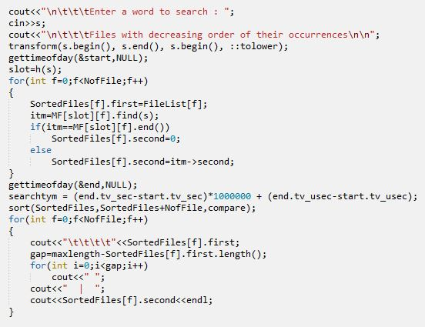
Case 5 - Searching
Word entered to search is transformed to lower case. Slot number is calculated using hash function. The word is searched in the map corresponding to slot number-
If the word is found then its frequency is returned.
Else if the word is not found, zero is returned.
Process is repeated for all files.

Slide 47
Case 5 – Searching (Visual Representation)
0
1
2
3
4
5
6
7
8
it
17
has
15
told
20
god
11
hit
23
the
8
was
27
Searching the word – “the”

Slide 48
Case 5 – Searching (Visual Representation)
0
1
2
3
4
5
6
7
8
Frequency = 0
it
17
has
15
told
20
god
11
hit
23
the
7
was
19
Searching the word – “moon”

Slide 49

Case 5 – Theoretical Analysis
Assuming uniform hashing and uniform occurrence of a word in all the text files, the average number of nodes in a map will be $\frac{n}{F.m.f}$. So the insert time of a single node is same as searching the string in the map. Therefore average time complexity to insert $\frac{n}{F}$ strings in a Hash Table is $O\left(F.\frac{n}{F}.\log\left(\frac{n}{F.m.f}\right)\right)=O(n.\log\left(\frac{n}{F.m.f}\right))$.
Taking $\frac{n}{F.m}= α$, Build Time complexity is $O\left(n.\log\left(\frac{n}{F.m.f}\right)\right)=O(n.log⁡(\frac{α}{f}))$.
Search time is logarithmic in the number of nodes in a Map. Calculating Hash value takes constant time so search time complexity is $O\left(F.log\left(\frac{n}{F.m.f}\right)\right)=O(F.log⁡(\frac{α}{f}))$.

Slide 50

Case 5 – Pros and Cons
Pros –
Search time is logarithmic in the number of nodes as Maps use balanced trees internally.
Very less space is used as just one node is sufficient to represent all the same words in a file.
Search Time is reduced by a factor of $m$ i.e., the number of slots in a Hash Table.
Cons –
Insertion time is not linear in the number of nodes in the Map.
Pointers take up a appreciable constant factor of space.

Slide 51
Case - 6
Unordered maps storing frequency

Slide 52
Case 6 – Insertion
We traverse the string from the start and the end till we encounter alphanumeric characters in order to get rid of punctuations if any. We take the valid substring and transform it in to lower case. String is searched in the unordered map
if the substring is already present then its frequency is incremented.
if not found, substring is inserted and its frequency is made 1.
Max load factor determines the maximum number of nodes that can be present in a bucket (slot).
If this load factor is crossed, the elements are rehashed to keep the constrain.

Slide 53
Case 6 – Insertion (Visual Representation)
0
alice | 22
was | 17
MAX
LOAD
FACTOR
MAXIMUM
AVERAGE
ELEMENTS
PER
BUCKET
1
is | 18
there | 32
will | 35
Hash Function
2
be | 16
gone | 17
3
the | 8
mark | 7
to | 45
the | 7
4
sun | 11
star | 5
3
5
moon | 9
elf | 34
tell | 25
BUCKETS

Slide 54
Case 6 – Searching
Word entered to search is transformed to lower case. The word is searched in the string variable of every element of the bucket corresponding to the word.
If the word is found then the integer variable of that vector element, representing its frequency is returned.
Else if the word is not found, zero is returned.

Slide 55
Case 6 – Searching (Visual Representation)
0
in | 45
to | 11
be | 3
1
cause | 34
will | 25
go | 12
Hash Function
2
our | 4
son | 1
sank | 2
3
sun | 17
the | 10
burn | 3
4
down | 16
doe | 6
went | 9
3
5
bye | 4
star | 1
moon | 2
Frequency = 10

Slide 56

Case 6 – Theoretical Analysis
The hash function of the unordered map calculates the bucket in constant time. The string is first searched in the bucket. The maximum number of elements in a bucket is given by the unordered_map::max_load_factor variable which is a constant. So the insertion time is $O(1)$. So to insert $n$ words, the average time complexity is $O(n)$.
If the number of elements in a bucket crosses the max_load_factor, then the elements are rehashed which takes $O(n)$. So the amortized worst case of insertion of one element is $\frac{O\left(n\right)+O\left(n\right)}{n}=O(1)$.

Slide 57

Case 6 – Theoretical Analysis
In case of searching the corresponding bucket with the hash value of the word is iterated. As soon as the word is encountered the frequency part is returned. So the average search time complexity for one file will be $O(1)$ since number of elements in the bucket is constant. Therefore total search time complexity is $O(F)$.

Slide 58

Case 6 – Pros and Cons
PROS
Searching takes $O(1)$ which is better than $θ(α)$ in case 1 assuming f>1.
Space complexity of this case is $θ(\frac{n}{f})$ better than $θ(n)$ of first case.
As no pointers used so an appreciable constant amount of space saved.
Build time is $O(n)$ which is better than all other cases except its comparable to case 3 and 1 which also takes $O(n)$ time.
CONS
Insertion takes $O(\frac{n.α}{f})$ which is worse than $θ(n)$ of case 1 generally.

Slide 59
Comparison of all 6 cases

Slide 60

Conventions used
$n$ = Total number of alphanumeric words in all the Text Files
$F$ = Total number of Text files in the present directory
$f$ = Average frequency of any word in all the Text files.
$m$ = Number of slots/buckets in a Hash Table
$α$ = $\frac{n}{F.m}$

Slide 61
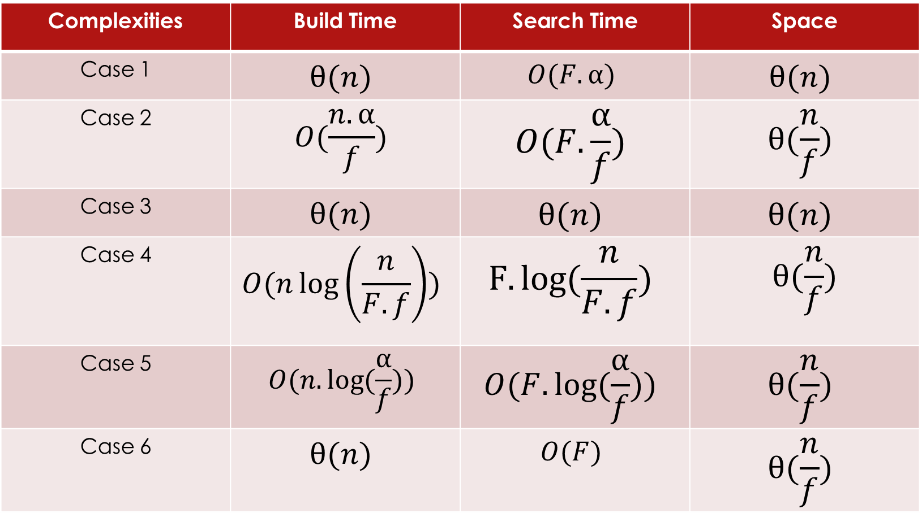
Theoretical Comparison (as discussed)
Complexities | Build Time | Search Time | Space
Case 1 | $$θ(n)$$ | $$O(F.α)$$ | $$θ(n)$$
Case 2 | $$O(\frac{n.α}{f})$$ | $$O(F.\frac{α}{f})$$ | $$θ(\frac{n}{f})$$
Case 3 | $$θ(n)$$ | $$θ(n)$$ | $$θ(n)$$
Case 4 | $$O(n\log\left(\frac{n}{F.f}\right))$$ | $$F.log⁡(\frac{n}{F.f})$$ | $$θ(\frac{n}{f})$$
Case 5 | $$O(n.log⁡(\frac{α}{f}))$$ | $$O(F.log⁡(\frac{α}{f}))$$ | $$θ(\frac{n}{f})$$
Case 6 | $$θ(n)$$ | $$O(F)$$ | $$θ(\frac{n}{f})$$

Slide 62
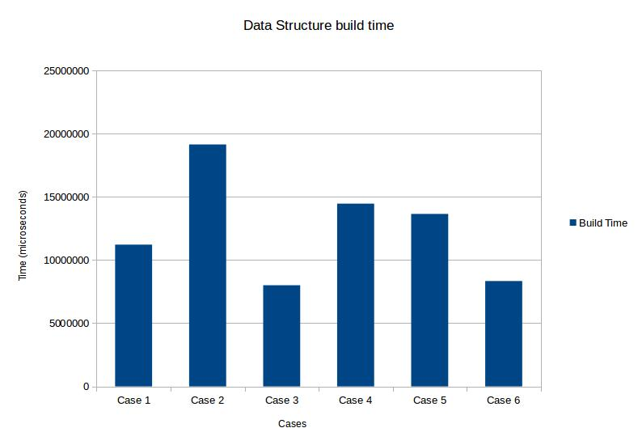
Statistical Data Analysis
A bar plot showing the build times in all the cases when 100MB of text files were used as input.

Slide 63
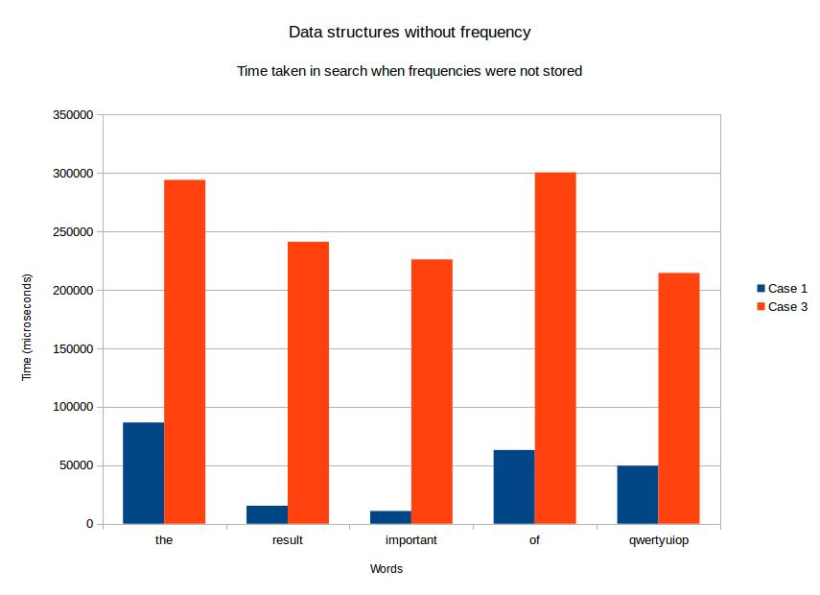
Statistical Data Analysis
A bar plot showing search time of different words in cases when data structures were not storing frequencies.
Size of all text file was 100MB

Slide 64
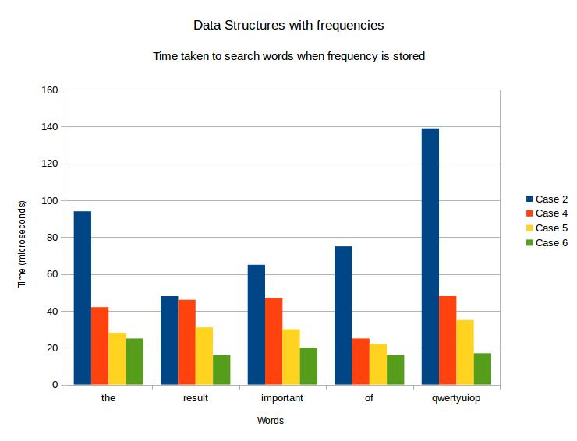
Statistical Data Analysis
Bar plot showing search time of cases when different words where searched in Data structures storing frequencies.
Size of all text files was 100MB

Slide 65
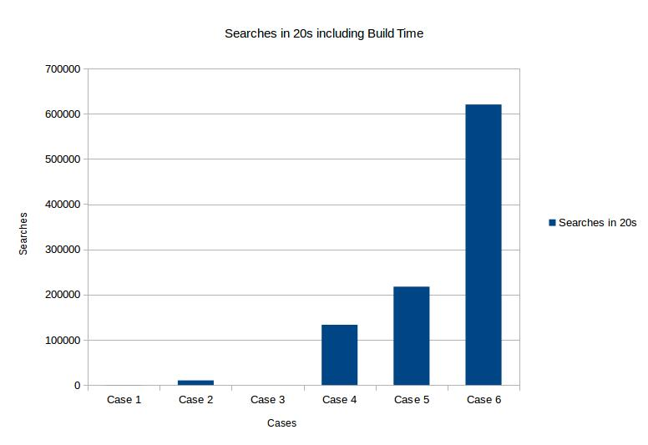
Statistical Data Analysis
A bar plot showing the number of times we can search in 20 seconds including build time.
Size of all text files was 100MB

Slide 66
Statistical Data Analysis
Cases | Space consumed in RAM 100 MB text files
Case 1 | 643 MB
Case 2 | 4 MB
Case 3 | 643 MB
Case 4 | 8 MB
Case 5 | 8 MB
Case 6 | 4 MB

Slide 67

Comparative Analysis of Build Time
From the theoretical analysis we find that Cases 1, 3 and 6 take $O(n)$ time which is critical as all the elements have to be addressed at least once.
From the statistical data we find that the above fact is very well reflected in Cases 1, 3 and 6 as the they take the least build time amongst the 6 cases.

Slide 68

Comparative Analysis of Search Time
From the theoretical analysis we see that Case 6 takes least time complexity of $O(F)$ followed by Cases 5 and 4 with complexities $O(F.log⁡(\frac{α}{f}))$ and $O(F.log⁡(α.m))$.
From the statistical data we find that again Cases 4, 5 and 6 take the least time to search a word with case 6 as the best.

Slide 69

Comparative Analysis of Space Complexity
Theoretically, Data structures in Cases 1 and 3 store all the alphanumeric words of the text files, so a huge amount of memory is wasted in storing the words again and again.
Each node also takes space in storing pointers which further increase the memory usage.
Cases 2, 4, 5 and 6 store only DISTINCT words so theoretically they take $O(\frac{n}{f})$ space which is drastically visible in our data.
In cases 4 and 5 we use Balanced trees which take more number of pointers so the space observed is greater as seen in cases 2 and 6.

Slide 70
Result
Combining the theoretical and statistical data for Time and Space complexity we can safely conclude that Case 6 which uses unordered maps is the best suited for our program.

Slide 71
Thank You

